Slide 1
Introduction to Object Oriented
Programming in Python

Slide 2
Why OOP (from last time)?
Often we describe real-life objects in code (which is easier with OOP),
With OPP, it is easy to reuse previously written code,
• …
Every bigger real-life project will be written in OOP.

Slide 3
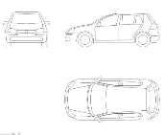
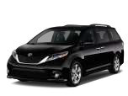


Object oriented programming
Object in Python is a representation of a person, a place, a bank account, a car, or any item that the program should handle.
Object Oriented Programming Recipe:
  (1) define classes (these are descriptions)
  (2) make object instances out of classes.
Class Car
Car instances

Slide 5

OOP with a Taxi Example
To learn OOP, we will use an example of a Taxi.

Slide 6

Example Object - Taxi
Every object has two main components: Data (the attributes about it) Behavior (the methods)
DATA
DriverName
OnDuty
NumPassenger
Cities
BEHAVIOR
PickUpPassenger
DropOffPassenger
SetDriverName
GetDriverName

Slide 7
Taxi
DriverName: string OnDuty: Boolean NumPassenger: int Cities:list
PickUpPassenger():int DropOffPassenger(): int SetDriverName(string) GetDriverName:string

Slide 8
Creating a simple class in Python
In a class, we describe (1) how the object will look like, and (2) what behavior it will have.
Classes are the blueprints for a new data type in your program!
A class should have at minimum*:
  A name (e.g. Class Taxi)
  A constructor method (that describes how to create a new object,
init )

Slide 9
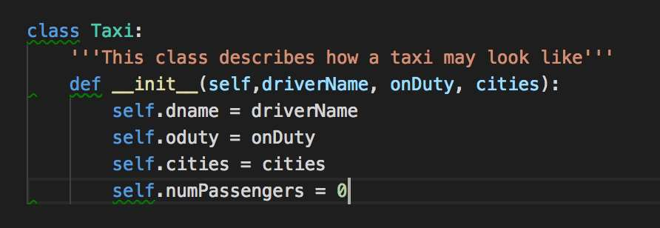

Example Class
CLASS NAME

Slide 10
The init method
init is a special method in Python classes,
The init method is the constructor method for a class
init is called when ever an object of the class is constructed.
Programmer makes a new object
init method is called
Behaviour within the
init method executes
myTaxi = Taxi;͞Aleks͟Ϳ
…
Self.taxiDriver = ͞Aleks͟
…

Slide 11
Example Object - Taxi
DATA
DriverName
OnDuty
NumPassenger
Cities

Slide 12
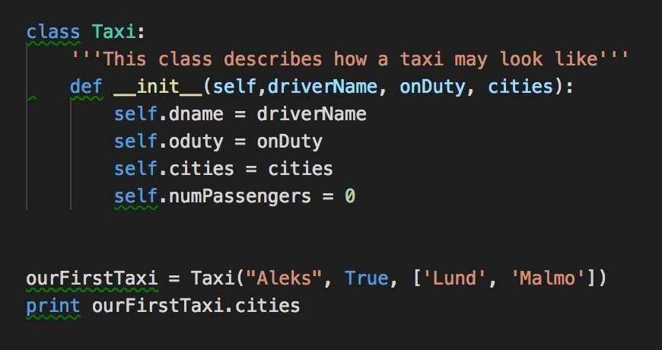
Creating an object from the class
From one class, you make objects (instances).

Slide 13
Object Creation Flow
To create a new object, use the class name

Slide 14
Object Creation Flow
To create a new object, use the class name
When you create a new object, the init method from the class is
called with the parameters that were passed.

Slide 15
Object Creation Flow
The init method Is called

Slide 16
Example Object - Taxi
DATA
DriverName
OnDuty
NumPassenger
Cities
BEHAVIOR
PickUpPassenger
DropOffPassenger
SetDriverName
GetDriverName

Slide 17
Behavior of a class
classes/objects can have methods just like functions except that they have an extra self variable at the beginning.
An object method takes as the first parameter the object (self) and can accept any number of other parameters.

Slide 18
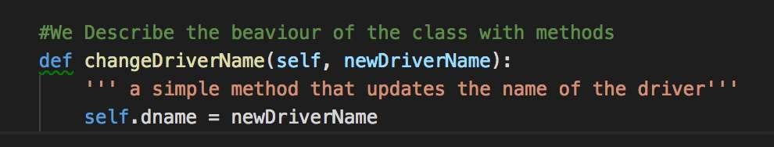
Example Object Method
This method changes the name of the taxi driver for the passed object (self).

Slide 19
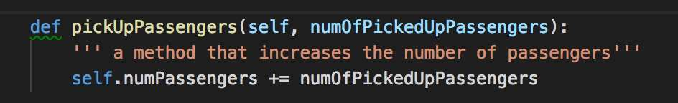
Another example of an object method

Slide 20
Exercise: Write a class that describes a Bus.
A bus is created with a number of seats, a color, and is driven by a bus driver that has a name. New passengers can get in the bus, and existing bus passengers can leave their seat and get of the bus.
Instructions
Start by drawing a class diagram
Create a class for the bus in python
Create two objects of your class

Slide 21
Object vs. Class Variables
Most variables are object specific (for example, the variable number of passengers in a taxi is different for every taxi that we create).
Some variables are common to all objects (for example, if we want to count the number of taxis that we have in our company)
Class Taxi -> number_of_taxi_vehicles = 7
T1
T2
T7

Slide 22
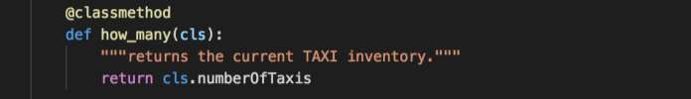
Accessing class variables
To access a class variable within a method, we use the @classmethod decorator, and pass the class to the method.

Slide 23
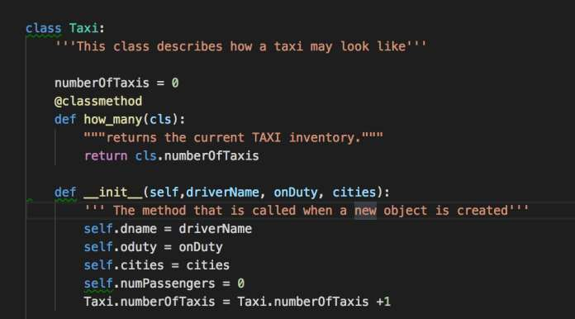
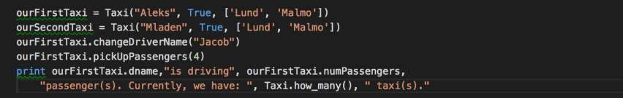
Example use of class variable

Slide 24
Exercise2: Update your class Bus.
As an owner of the bus company, I wish to keep track of the number of busses that people buy (create).
Instructions
Create a class variable
Increment a class variable on init
Create a @classmethod to print its value

Slide 25
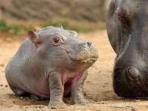
Exercise 3: Hippo ZOO
A local ZOO keeper wants to model his collection of Hippos in the Zoo.
Every hippo has a name and size (in kg). In the morning, a zoo keeper feeds the hypo so his weight increases. During the day the Hippo exercises, therefore his weight goes down.
A zoo keeper also needs a way to keep track how many Hippos he has in
the ZOO.
Model this problem (1) with a Class diagram & (2) in Python OOP code.

Slide 26
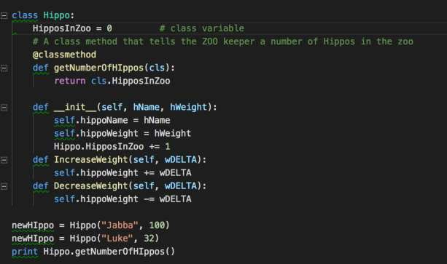
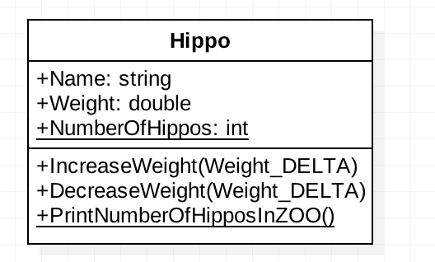
Example Solution

Slide 27
Takeaways
Today, we learned how to create simple classes and objects.
  A class is a blueprint for objects, and it contains attributes and behavior.
We added to our classes a number of:
  instance methods & instance variables (for example, color, size, etc.).
  class methods & class variables (for exmaple, a number of taxis).
We learned that new objects are created from a class through the
init method.

Slide 28
For Next time
In our next lecture, we will learn how to reuse the code that we have written today while describing other objects. We will learn about:
Inheritance. (TransportVehicle – Taxi)
Encapsulation (e.g. private functions)
Polymorphism (defining the same function for different types of objects)

